Slide 1
CARTOONS

Slide 2

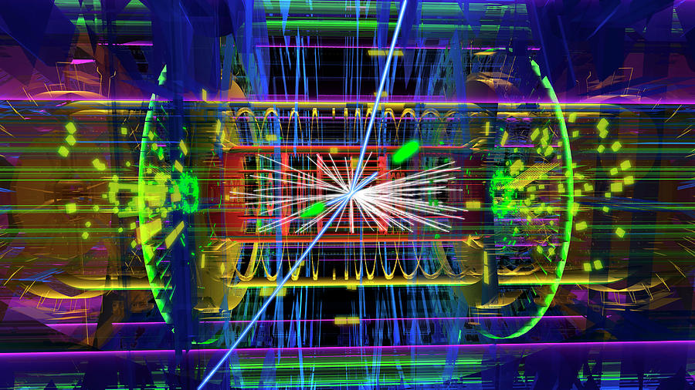
Particle colliders are a marvel of engineering, yet they
are primitive from the perspective of the point charge universe.
Notes:
With the architecture of nature in hand, we don’t need colliders to discover more about nature. In the point charge era, the real art is in discovering ways to tap into shielded energy as well as to transmute point charges safely.

Slide 3
Thank You
Questions?

